Slide 1
Tree-Growing Sample-Based Motion Planning

Slide 2
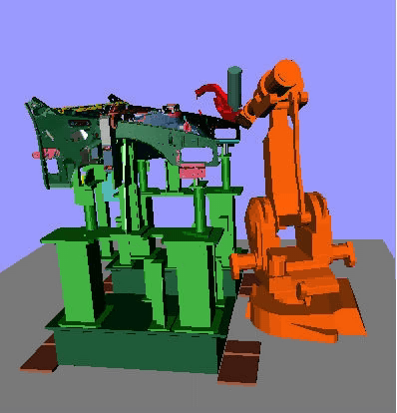
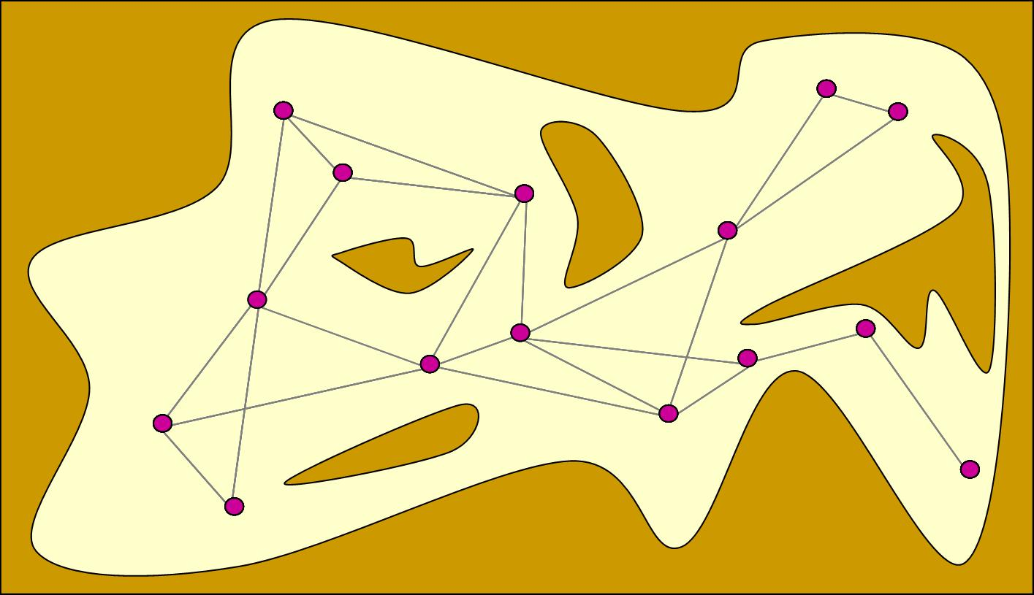
Probabilistic Roadmaps
What if only a small portion of the space needs to be explored?
What if omnidirectional motion in C-space is not permitted?

Slide 3
Tree-growing planners
Idea: grow a tree of feasible paths from the start until it reaches a neighborhood of the goal
Sampling bias toward “boundary” of currently explored region, helps especially if the start is in a region with poor visibility
Many variants:
Rapidly-exploring Random Trees (RRTs) are popular, easy to implement (LaValle and Kuffner 2001)
Expansive space trees (ESTs) use a different sampling strategy (Hsu et al 2001)
SBL (Single-query, Bidirectional, Lazy planner) often efficient in practice (Sanchez-Ante and Latombe, 2005)

Slide 4
RRT
Build a tree T of configurations, starting at x_{start}
Extend:
Sample a configuration x_{rand} from C at random
Find the node x_{near} in T that is closest to x_{rand}
Extend a short path from x_{near} toward x_{rand}
T

Slide 5
RRT
Build a tree T of configurations, starting at x_{start}
Extend:
Sample a configuration x_{rand} from C at random
Find the node x_{near} in T that is closest to x_{rand}
Extend a short path from x_{near} toward x_{rand}
x_{near}
x_{rand}

Slide 6
RRT
Build a tree T of configurations, starting at x_{start}
Extend:
Sample a configuration x_{rand} from C at random
Find the node x_{near} in T that is closest to x_{rand}
Extend a short path from x_{near} toward x_{rand}
x_{near}
x_{rand}

Slide 7
RRT
Build a tree T of configurations, starting at x_{start}
Extend:
Sample a configuration x_{rand} from C at random
Find the node x_{near} in T that is closest to x_{rand}
Extend a short path from x_{near} toward x_{rand}
x_{near}
x_{rand}

Slide 8
RRT
Build a tree T of configurations, starting at x_{start}
Extend:
Sample a configuration x_{rand} from C at random
Find the node x_{near} in T that is closest to x_{rand}
Extend a short path from x_{near} toward x_{rand}

Slide 9
RRT
Build a tree T of configurations, starting at x_{start}
Extend:
Sample a configuration x_{rand} from C at random
Find the node x_{near} in T that is closest to x_{rand}
Extend a short path from x_{near} toward x_{rand}
x_{rand}
x_{near}

Slide 10
RRT
Build a tree T of configurations, starting at x_{start}
Extend:
Sample a configuration x_{rand} from C at random
Find the node x_{near} in T that is closest to x_{rand}
Extend a short path from x_{near} toward x_{rand}

Slide 11
RRT
Build a tree T of configurations, starting at x_{start}
Extend:
Sample a configuration x_{rand} from C at random
Find the node x_{near} in T that is closest to x_{rand}
Extend a short path from x_{near} toward x_{rand}
Governed by a step size parameter δ

Slide 12
Implementation Details
Bottleneck: finding nearest neighbor each step
O(n) with naïve implementation => O(n²) overall
KD tree data structure O(n^{1-1/d})
Approximate nearest neighbors often very effective
Terminate when extension reaches a goal set
Usually visibility set of goal configuration
Bidirectional strategy
Grow a tree from goal as well as start, connect when closest nodes in either tree can “see” each other

Slide 13
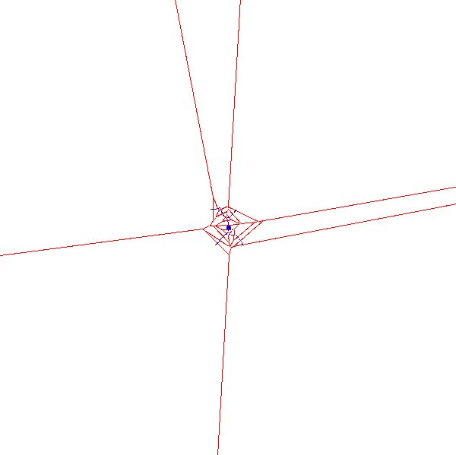
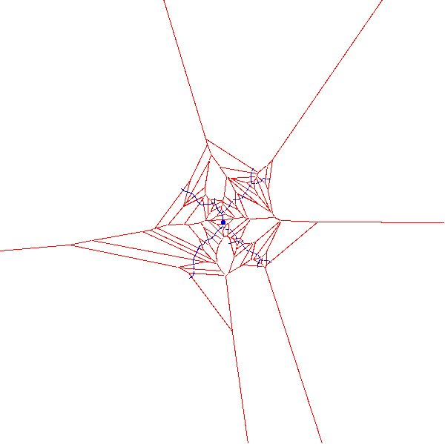
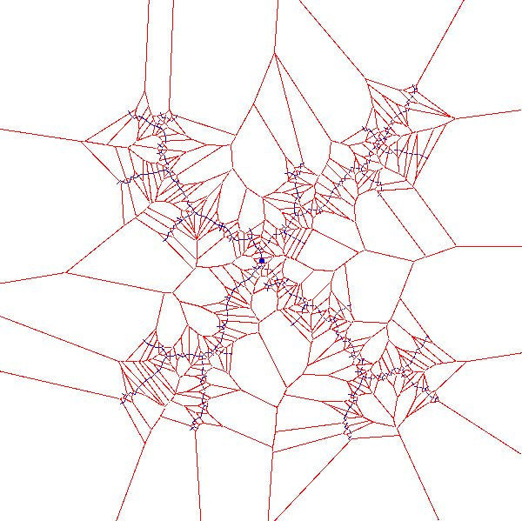
What is the sampling strategy?
Probability that a node gets selected for expansion is proportional to the volume of its Voronoi cell

Slide 14
Planning with Differential Constraints
(Kinodynamic Planning)

Slide 15
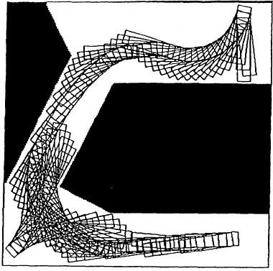
Paths for a Car-Like Robot
Notes:
15

Slide 16
Setting
Differential constraints
Dynamics, nonholonomic systems
dq/dt = Σ_{k} f_{k}(q)u_{k}
Vector fields
Controls
We’ll consider fewer control dimensions than state dimensions

Slide 17
Example: 1D Point Mass
Mass M
2D configuration space (state space)
Controlled force f
Equations of motion:
x
v
dx/dt = v dv/dt = f / M

Slide 18
Example: 1D Point Mass
x
v
v
dx/dt = dv dv/dt = f / M
Solution:
v(t) = v(0)+t f /M
x(t) = x(0)+t v(0) + ½ t² f / M
f=0
x

Slide 19
Example: 1D Point Mass
x
v
v
dx/dt = dv dv/dt = f / M
Solution:
v(t) = v(0)+t f /M
x(t) = x(0)+t v(0) + ½ t² f / M
f>0
x

Slide 20
Example: 1D Point Mass
x
v
v
dx/dt = dv dv/dt = f / M
Solution:
v(t) = v(0)+t f /M
x(t) = x(0)+t v(0) + ½ t² f / M
f<0
x

Slide 21
Example: 1D Point Mass
x
v
v
dx/dt = dv dv/dt = f / M
Solution:
v(t) = v(0)+t f /M
x(t) = x(0)+t v(0) + ½ t² f / M
|f|<=f_{max}
x

Slide 22
Example: Car-Like Robot
φ
dx/dt = v cosθ
dy/dt = v sinθ
dx sinθ – dy cosθ = 0
L
θ
θ
dθ/dt = (v/L) tan φ
y
φ
|φ| < Φ
x
Configuration space is 3-dimensional: q = (x, y, θ)
But control space is 2-dimensional: (v, φ) with |v| = sqrt[(dx/dt)²+(dy/dt)²]
Notes:
22

Slide 23
Example: Car-Like Robot
φ
dx/dt = v cosθ
dy/dt = v sinθ
dx sinθ – dy cosθ = 0
L
θ
θ
dθ/dt = (v/L) tan φ
y
φ
|φ| < Φ
x
q = (x,y,q)
q’= dq/dt = (dx/dt,dy/dt,dq/dt) dx sinq – dy cosq = 0 is a particular form of f(q,q’)=0
A robot is nonholonomic if its motion is constrained by a non-integrable equation of the form f(q,q’) = 0
Notes:
23

Slide 24
Example: Car-Like Robot
φ
dx/dt = v cosθ
dy/dt = v sinθ
dx sinθ – dy cosθ = 0
L
θ
θ
dθ/dt = (v/L) tan φ
y
φ
|φ| < Φ
x
Lower-bounded turning radius
Notes:
24

Slide 25
How Can This Work? Tangent Space/Velocity Space
φ
θ
L
(x,y,θ)
(dx,dy,dθ)
θ
θ
y
φ
x
dx/dt = v cosθ
dy/dt = v sinθ
y
(dx,dy)
dθ/dt = (v/L) tan φ
θ
x
|φ| < Φ
Notes:
25

Slide 26
How Can This Work? Tangent Space/Velocity Space
φ
θ
L
(x,y,θ)
(dx,dy,dθ)
θ
θ
y
φ
x
dx/dt = v cosθ
dy/dt = v sinθ
y
(dx,dy)
dθ/dt = (v/L) tan φ
θ
x
|φ| < Φ
Notes:
26

Slide 27
Nonholonomic Path Planning Approaches
Two-phase planning (path deformation):
Compute collision-free path ignoring nonholonomic constraints
Transform this path into a nonholonomic one
Efficient, but possible only if robot is “controllable”
Need for a “good” set of maneuvers
Direct planning (control-based sampling):
Use “control-based” sampling to generate a tree of milestones until one is close enough to the goal (deterministic or randomized)
Robot need not be controllable
Applicable to high-dimensional c-spaces
Notes:
27

Slide 28
Control-Based Sampling
PRM sampling technique: Pick each milestone in some region
Control-based sampling:
Pick control vector (at random or not)
Integrate equation of motion over short duration (picked at random or not)
If the motion is collision-free, then the endpoint is the new milestone
Tree-structured roadmaps
Need for endgame regions
Notes:
28

Slide 29
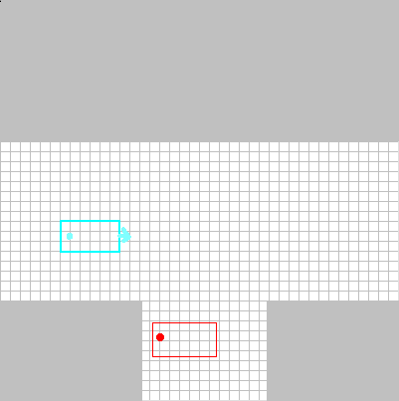
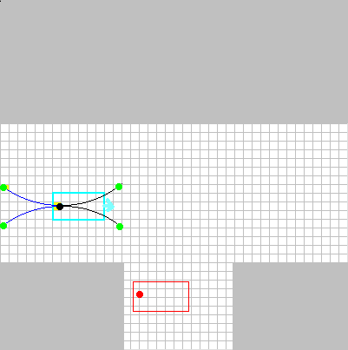
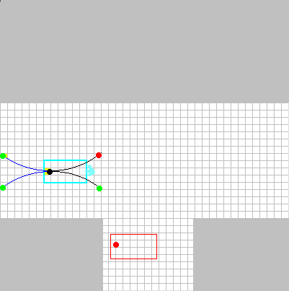
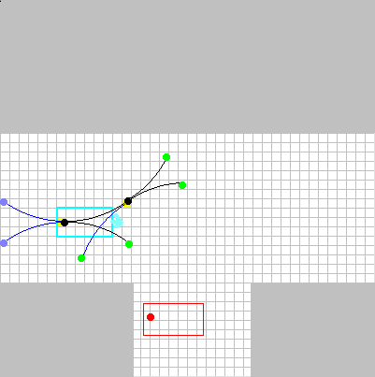
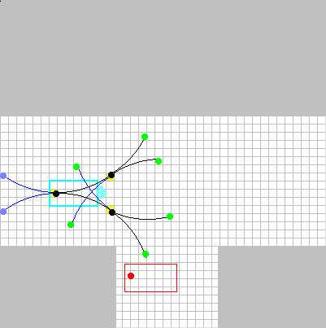
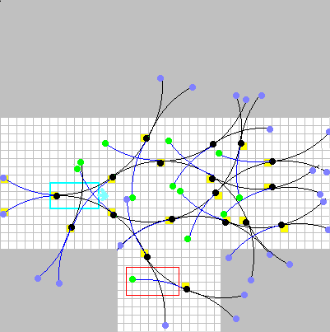
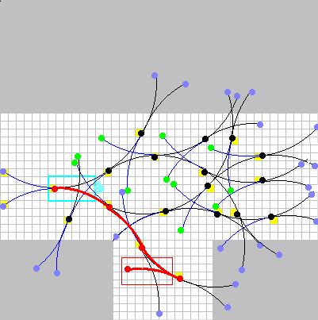
Example
dx/dt = v cosθ
dy/dt = v sinθ
dθ/dt = (v/L) tan φ
|φ| < Φ
1. Select a milestone m
2. Pick v, φ, and δt
3. Integrate motion from m
→ new milestone m’
Notes:
29

Slide 30
Example
Indexing array: A 3-D grid is placed over the configuration space. Each milestone falls into one cell of the grid. A maximum number of milestones is allowed in each cell (e.g., 2 or 3).
Asymptotic completeness: If a path exists, the planner is guaranteed to find one if the resolution of the grid is fine enough.
Notes:
30

Slide 31
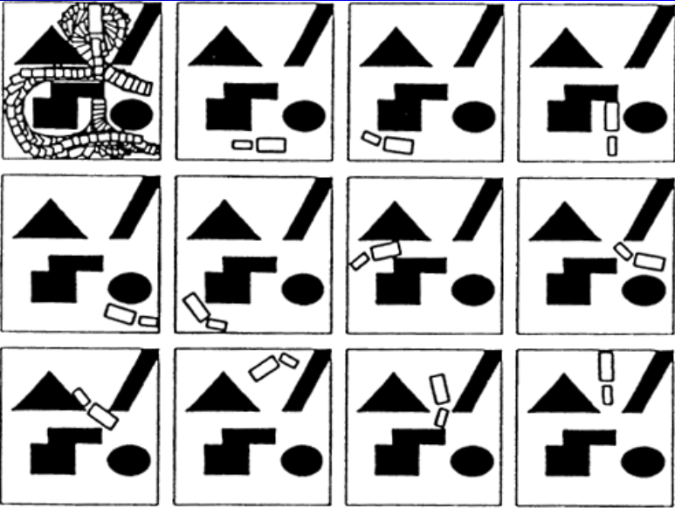
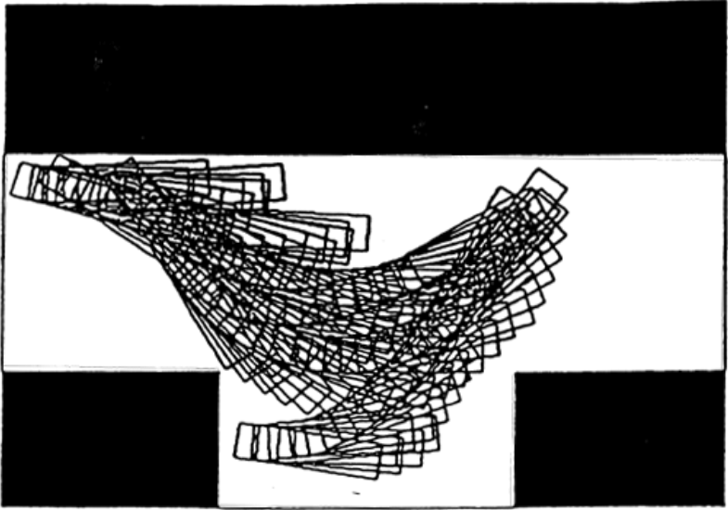
Computed Paths
Car That Can Only Turn Left
Tractor-trailer
ϕ_{max}=45º, ϕ_{min}=22.5º
ϕ_{max}=45º
Notes:
31

Slide 32
Control-Sampling RRT
Configuration generator f(x,u)
Build a tree T of configurations
Extend:
Sample a configuration x_{rand} from X at random
Find the node x_{near} in T that is closest to x_{rand}
Pick a control u that brings f(x_{near},u) close to x_{rand}
Add f(x_{near},u) as a child of x_{near} in T

Slide 33
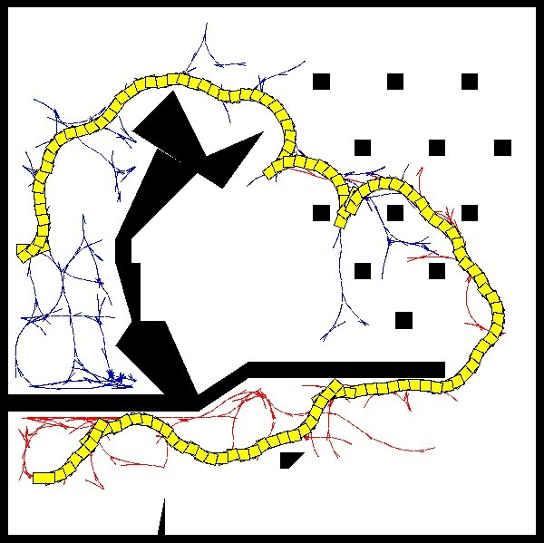

Slide 34
Weaknesses of RRT’s strategy
Depends on the domain from which x_{rand} is sampled
Depends on the notion of “closest”
A tree that is grown “badly” by accident can greatly slow convergence

Slide 35
Other strategies
Dynamic-domain RRTs (Yershova et al 2008)
Perturb samples in a neighborhood (EST, SBL)
Lazy planning: delay expensive collision checks until end

